Slide 1
OFW Monitoring System

Slide 2
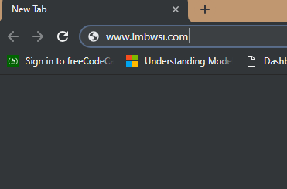
To open the system, type www.lmbwsi.com in your google chrome or browser.

Slide 3
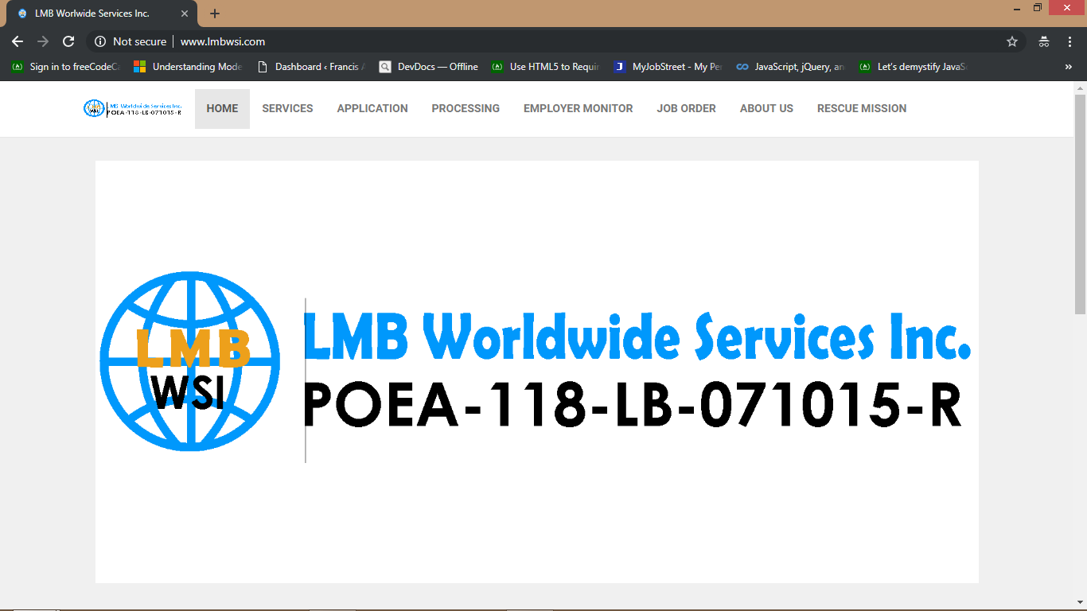

Slide 4
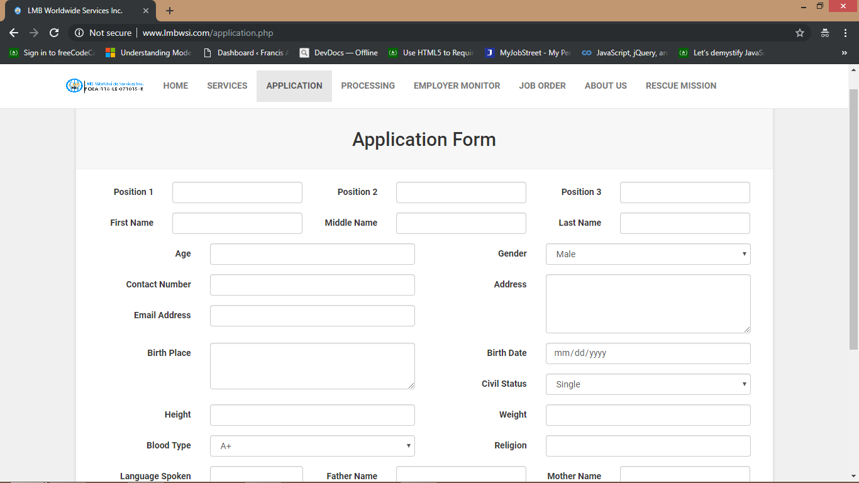
This is the application form where applicants who wants to apply can send their information online

Slide 5
The system has three user levels. It can access by the administrator(owner) , staffs and accounting. To access it, just click the Processing and it will redirect you to the login page.

Slide 6
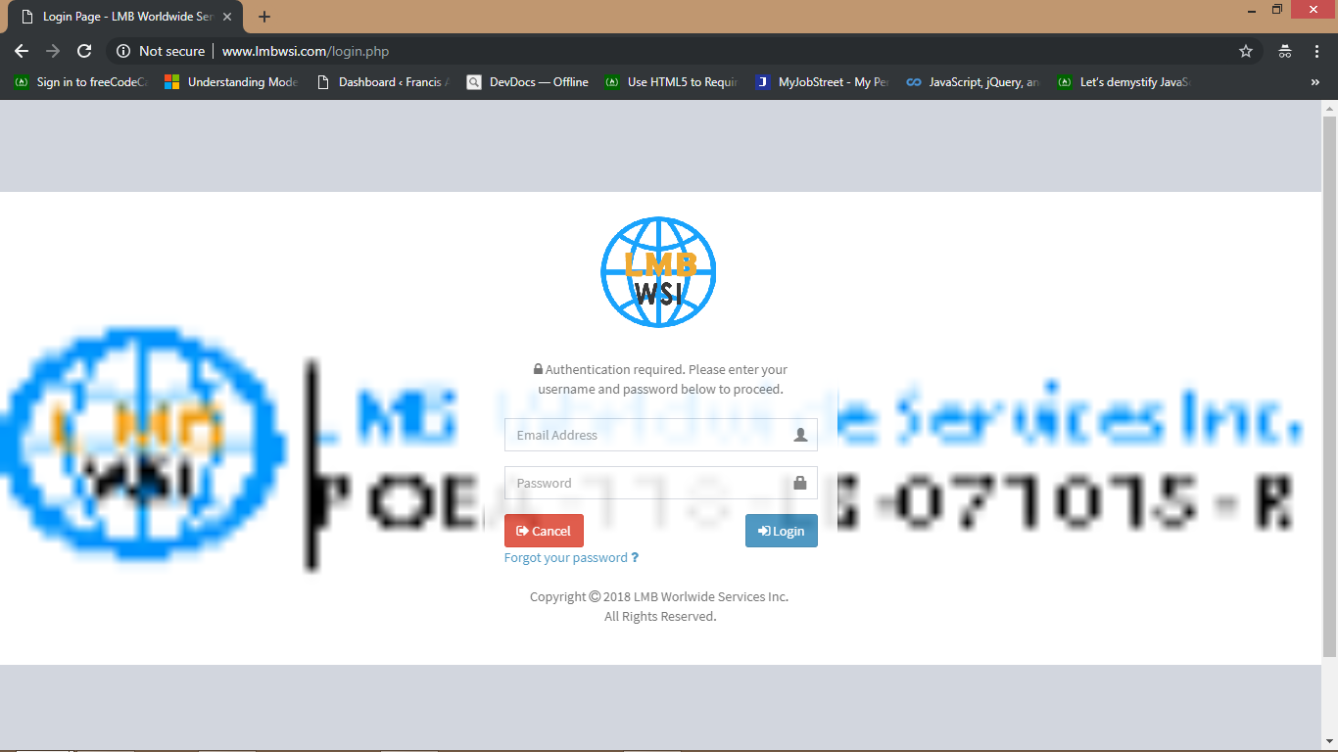
This is the login page where you can type your email address and your password. In the administrator, the default email address is admin@gmail.com and the password is admin123

Slide 7
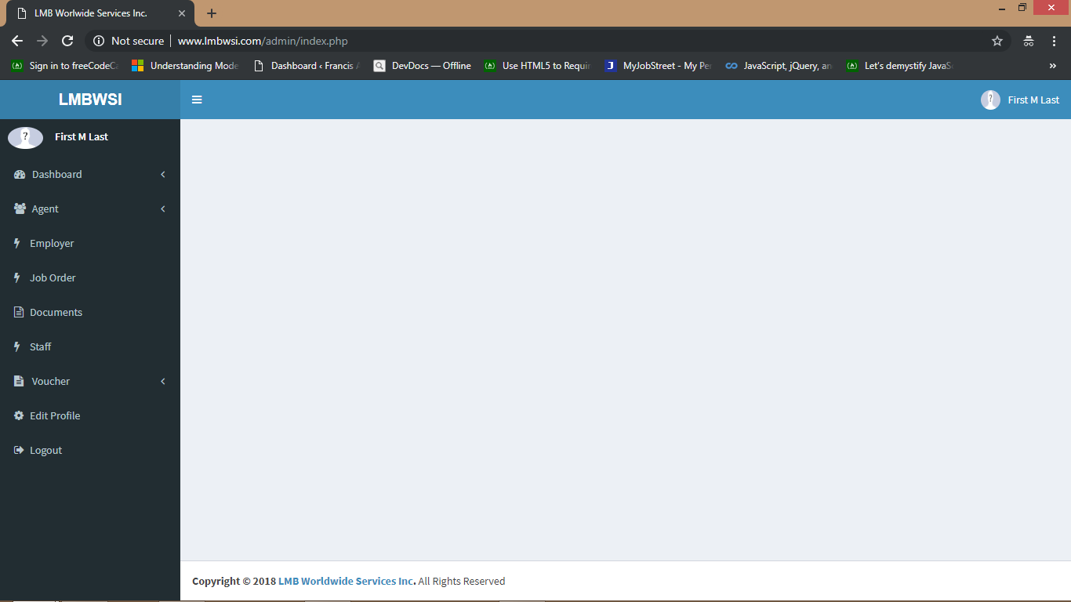
This is the administrator page. It can access all the transactions in the system

Slide 8
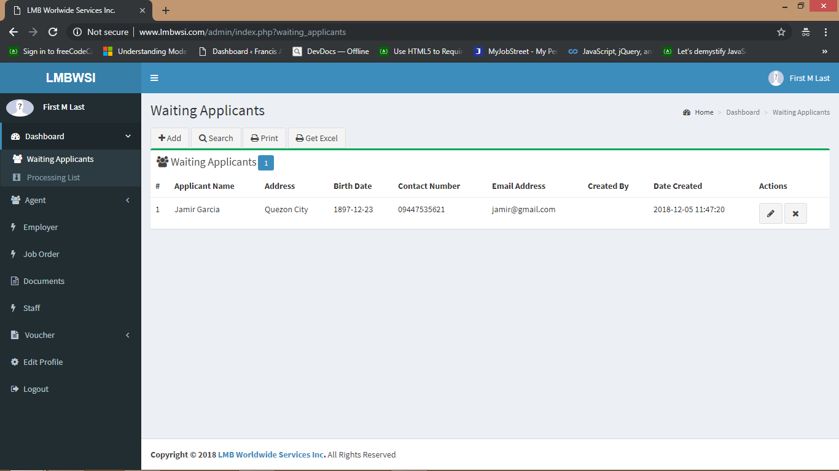
Waiting applicants meaning waiting list and it is where application from the application form go or the applicants who sends their information online

Slide 9
You can show the list of waiting applicants in excel type just click the Get Excel

Slide 10
To add Waiting Applicants, click the Add.

Slide 11
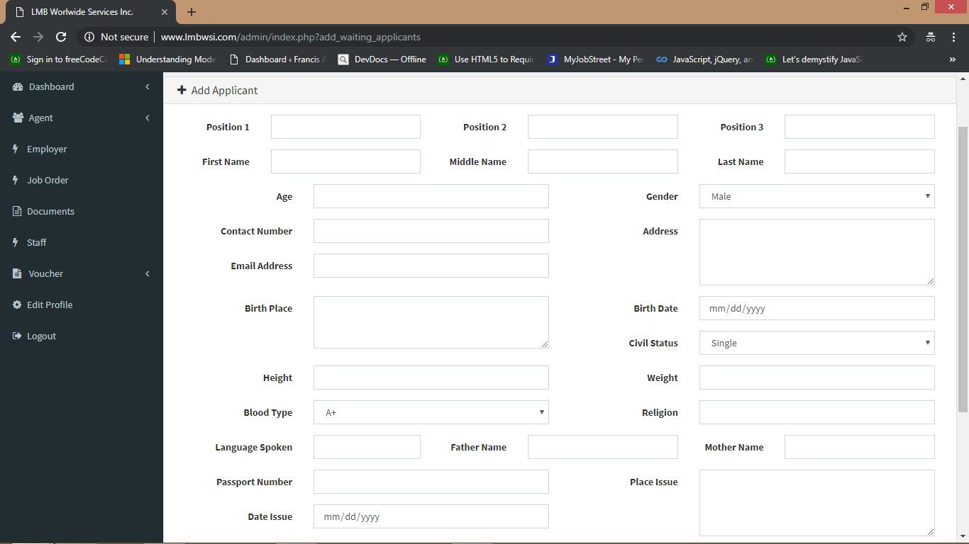

Slide 12
You can edit their information just click the pencil button. You can also remove applicant from the list , click the X button

Slide 13
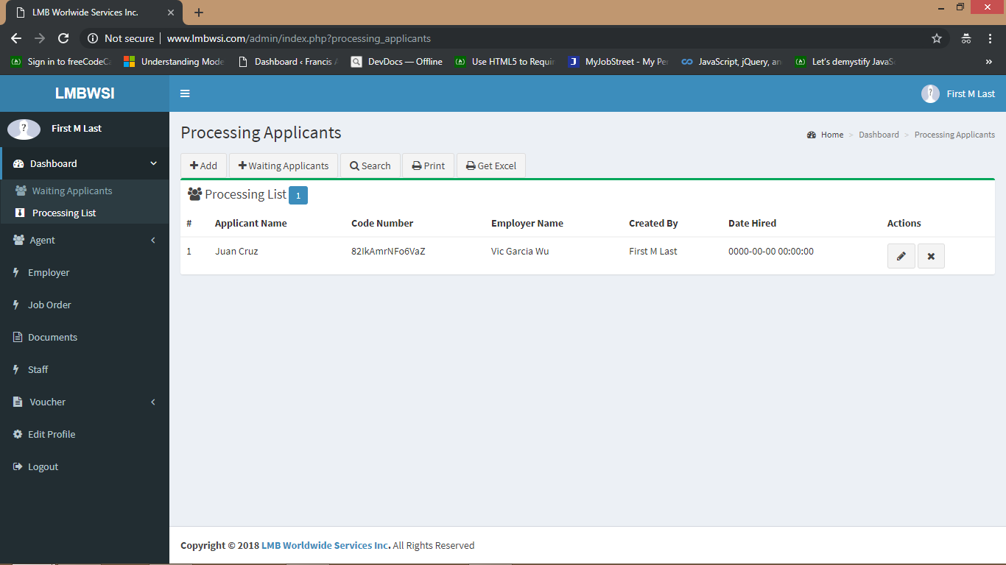
Processing applicants meaning accept from the employer , ready to go . In short hired.

Slide 14
To add Processing Applicants, click the Add

Slide 15
You can also add from the list of waiting applicants. Click waiting applicants

Slide 16
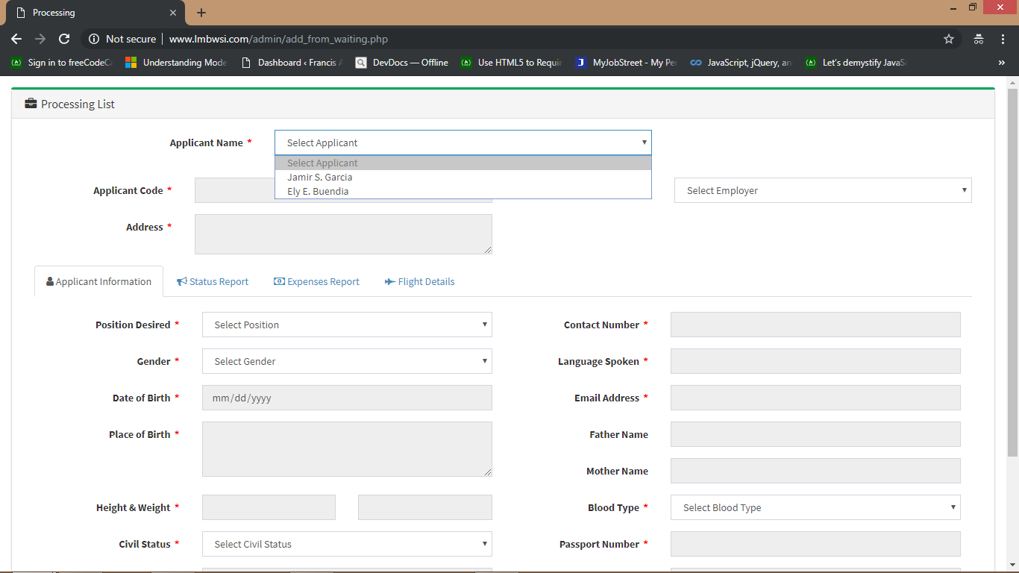
Select the name of the applicant and it will display their information

Slide 17
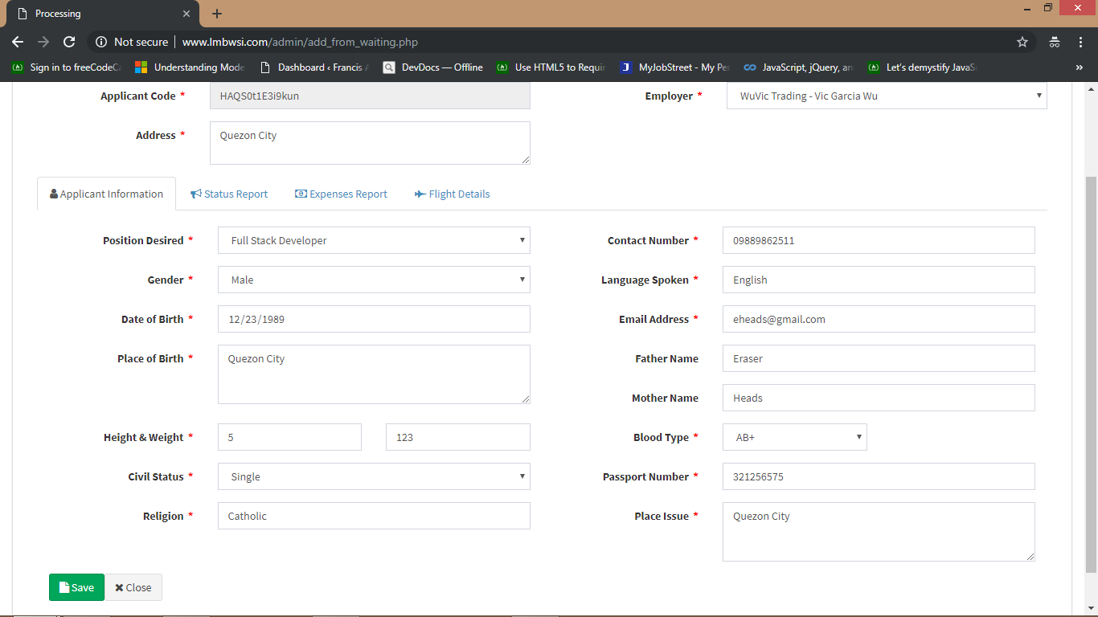
Then click the save to add

Slide 18
You can edit the applicants just click the pencil button

Slide 19
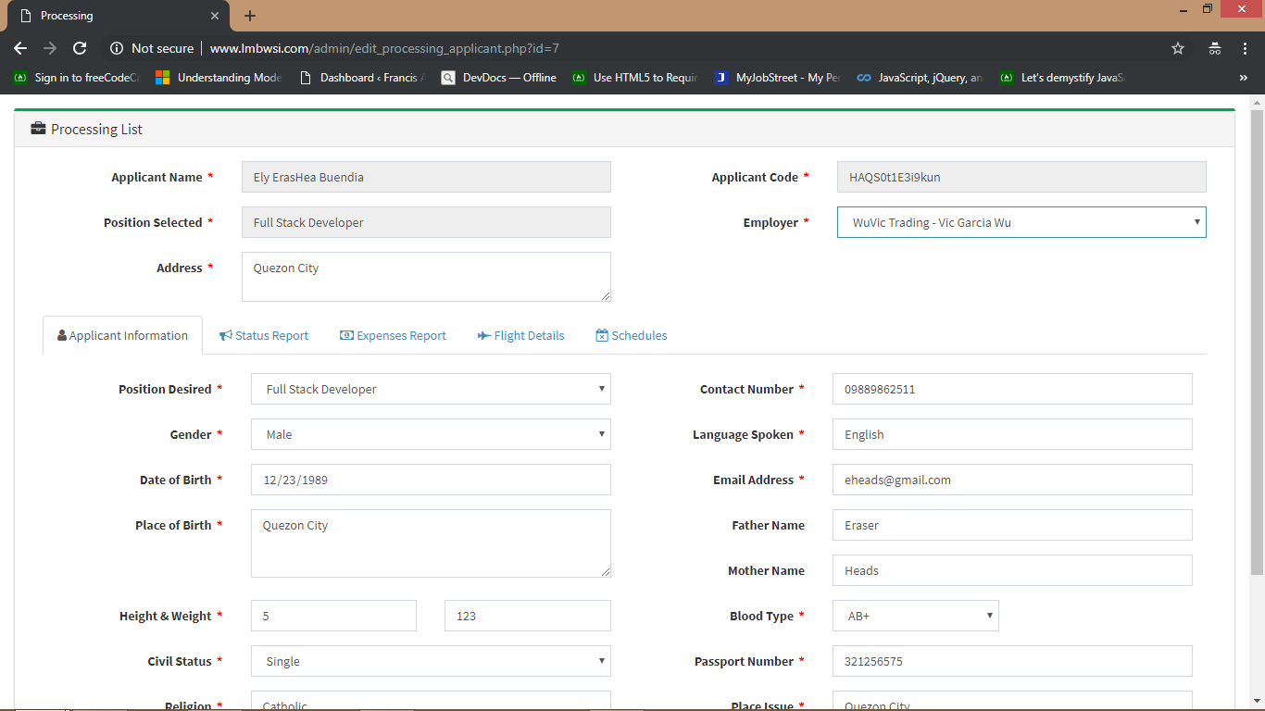

Slide 20
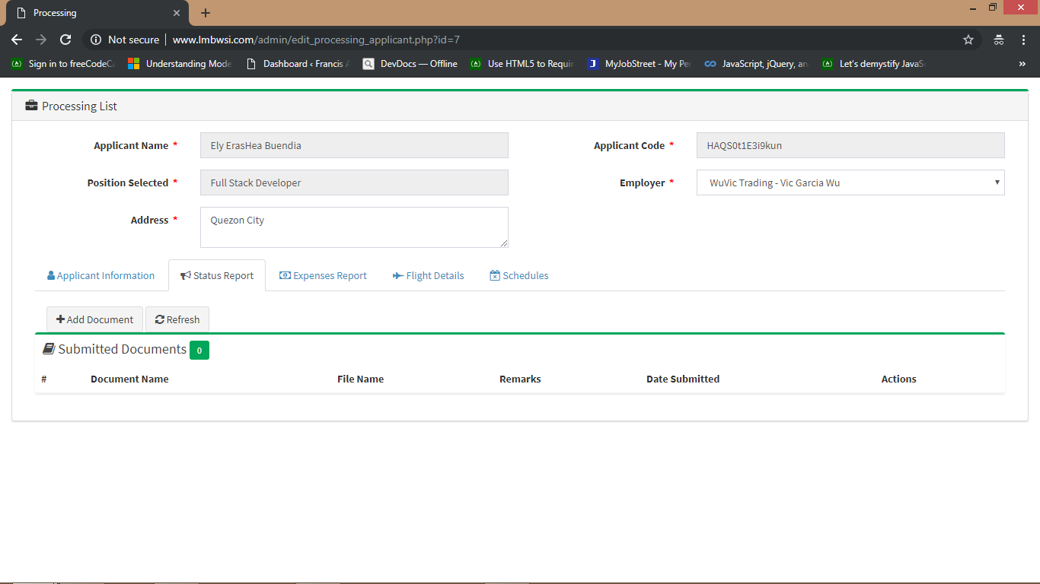
In the Status Report , you can view the documents submitted by applicants. To add a documents, click add documents

Slide 21
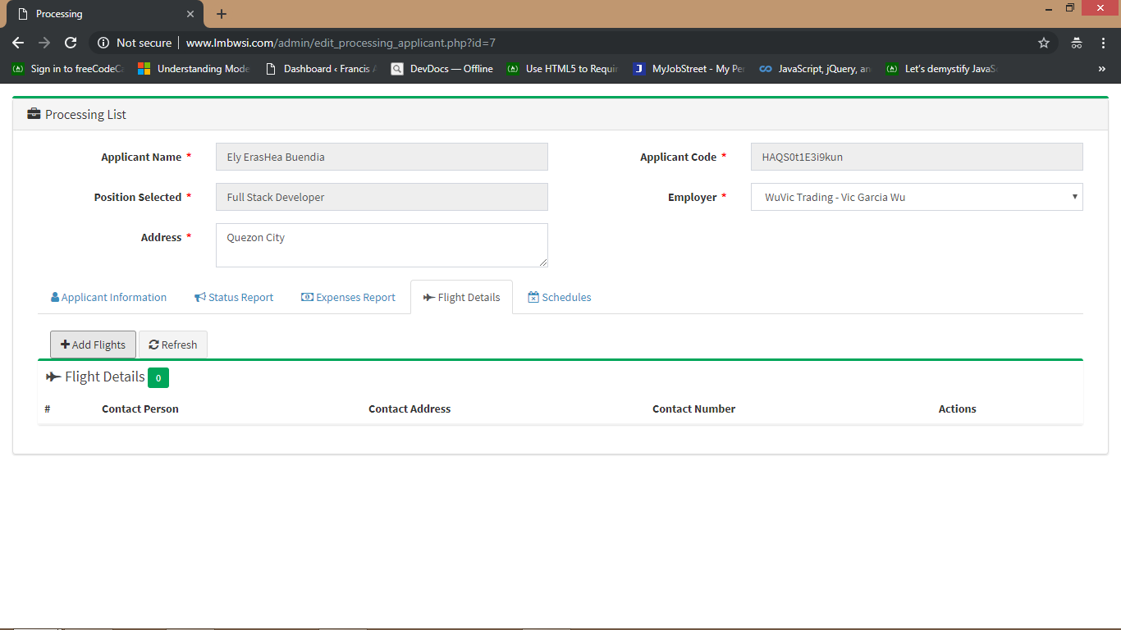
In the Flight Details, you can view the details of their flight. To add flight details, click add flight

Slide 22
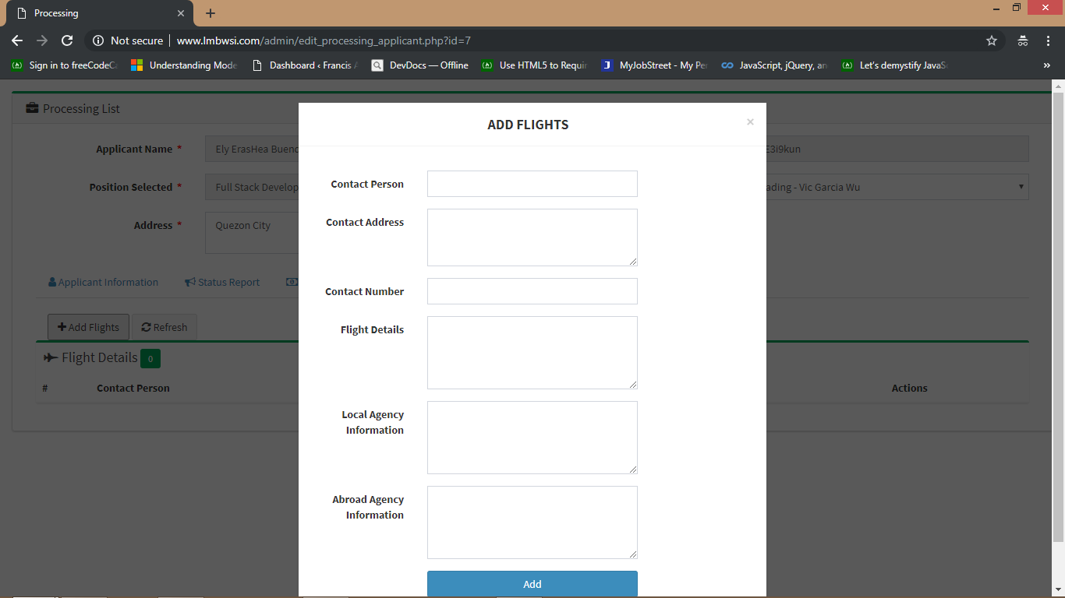

Slide 23
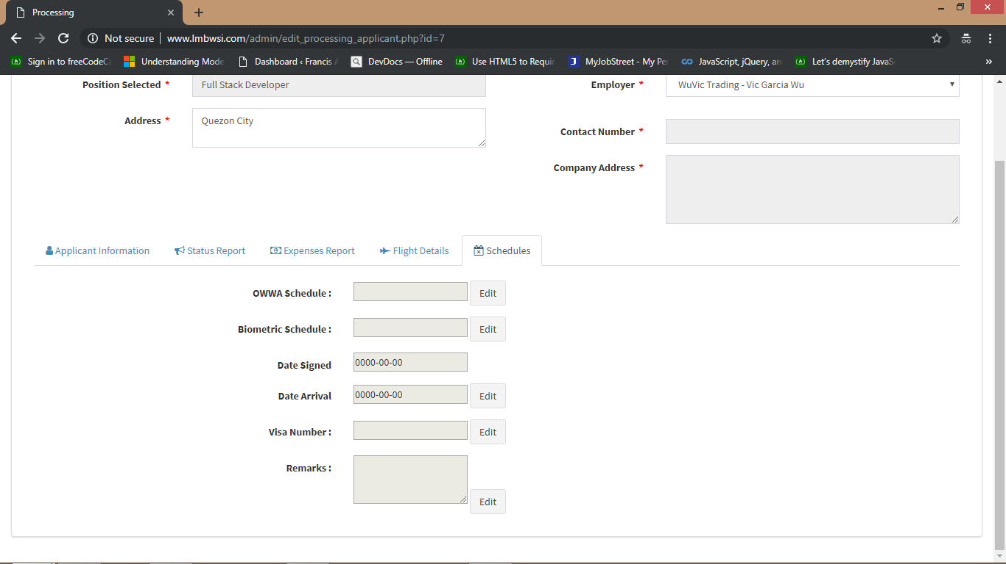
In the Schedules, you can set the OWWA and Biometric Schedule of the applicant . You can also set applicants visa number, contract Signed and Date arrival

Slide 24
If your done or you want to close , go to application information and at the bottom click Save

Slide 25
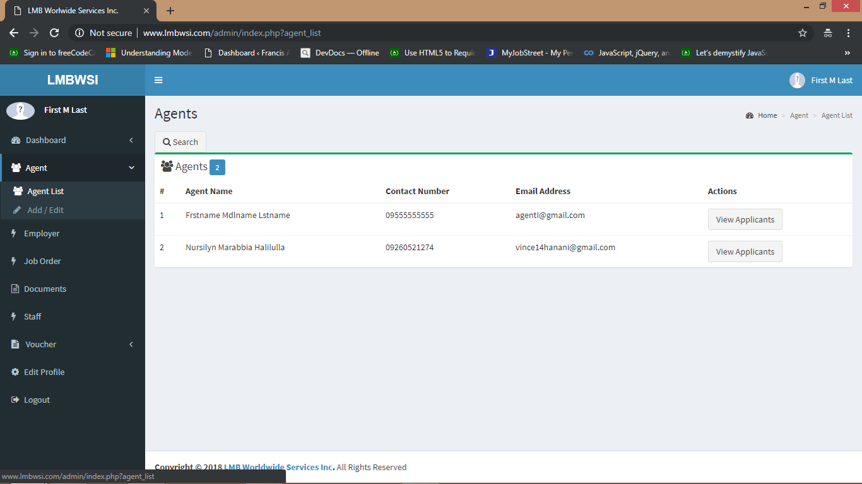
In the agent list, you can view the applicants of that agent. Click view Applicants

Slide 26
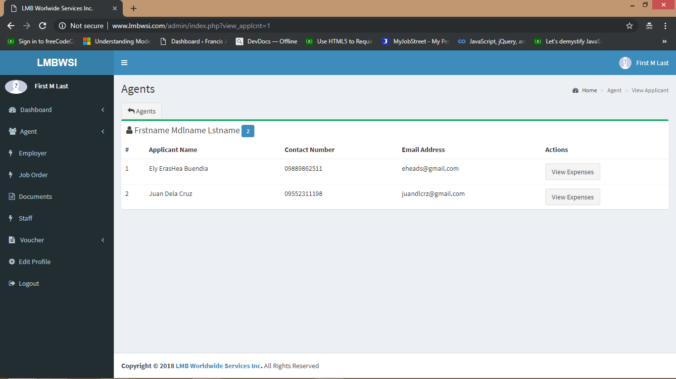
Then you can view the expenses

Slide 27
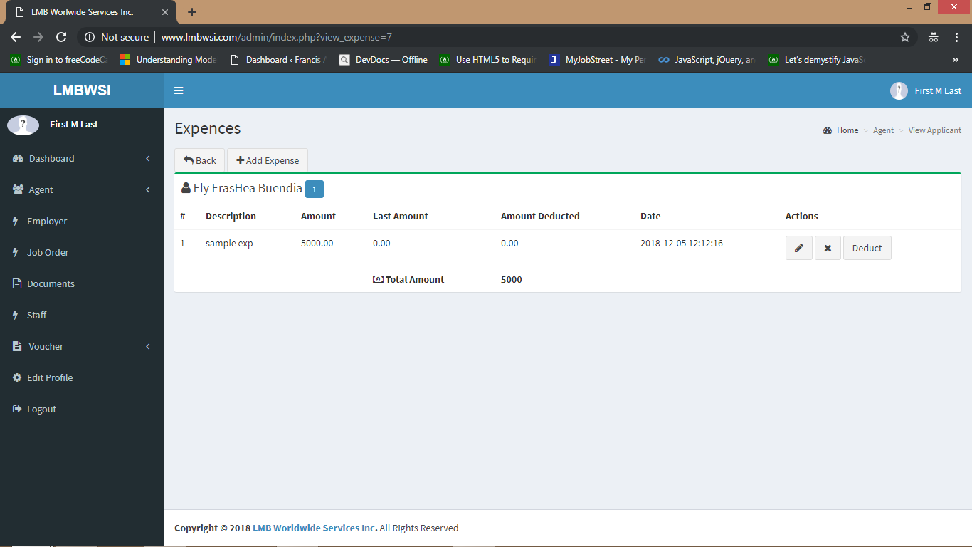
You can add expense, edit, remove or deduct

Slide 28
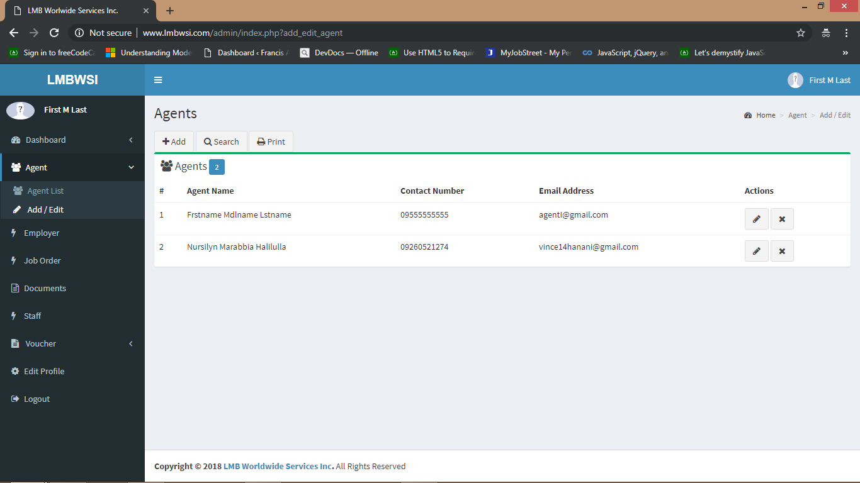
In the Add/ Edit , you can add, edit, or remove agent

Slide 29
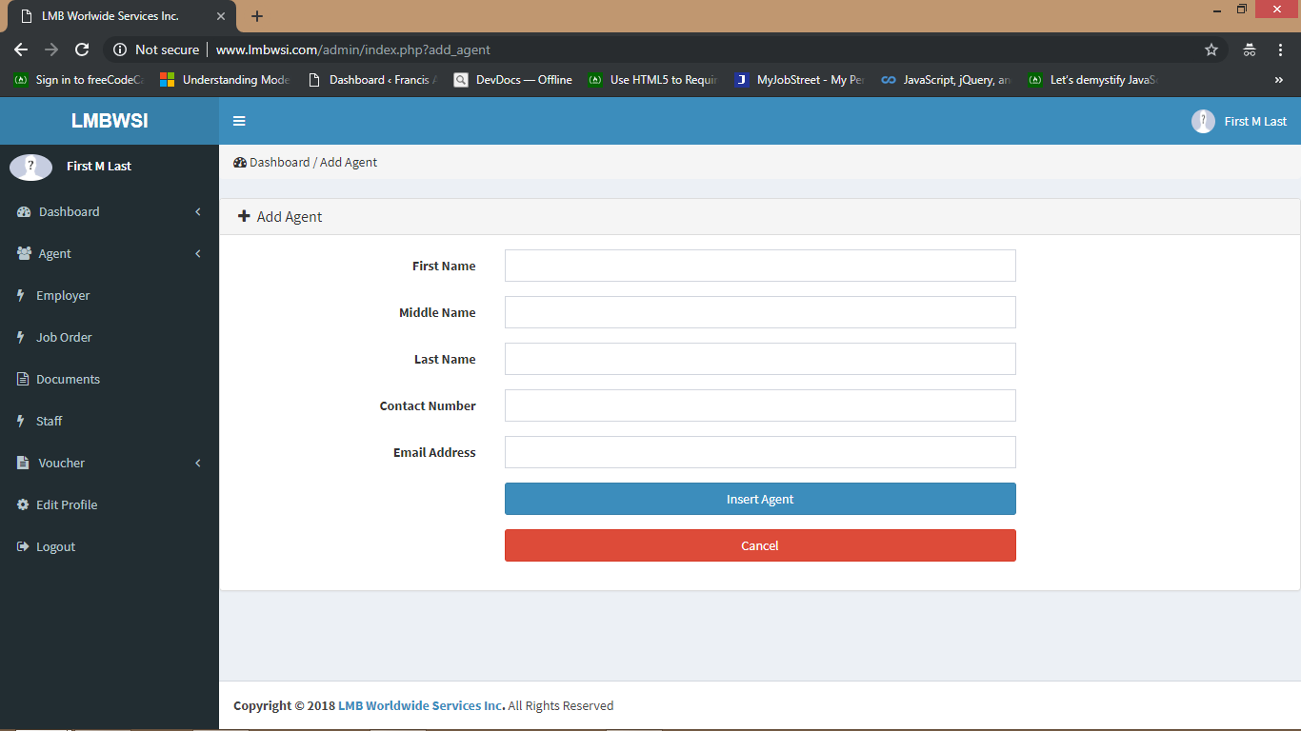

Slide 30
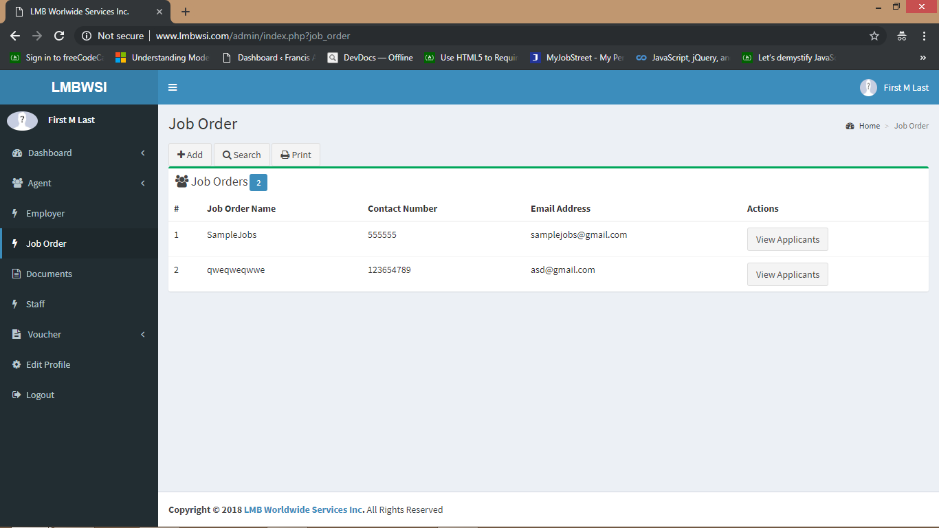
In the Job Order, you can add job orders and view the applicants

Slide 31
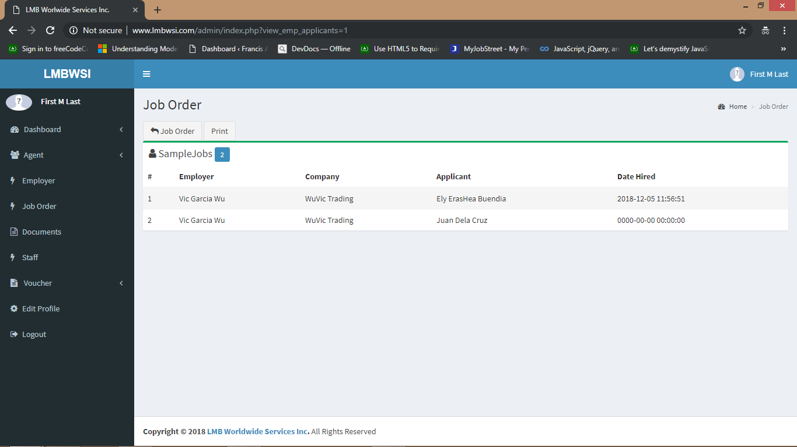

Slide 32
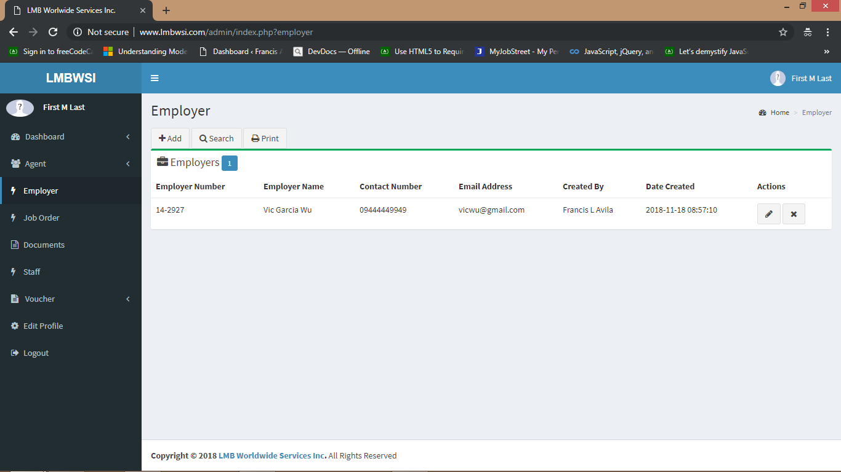
In the Employer, you can add , edit or remove Employers

Slide 33
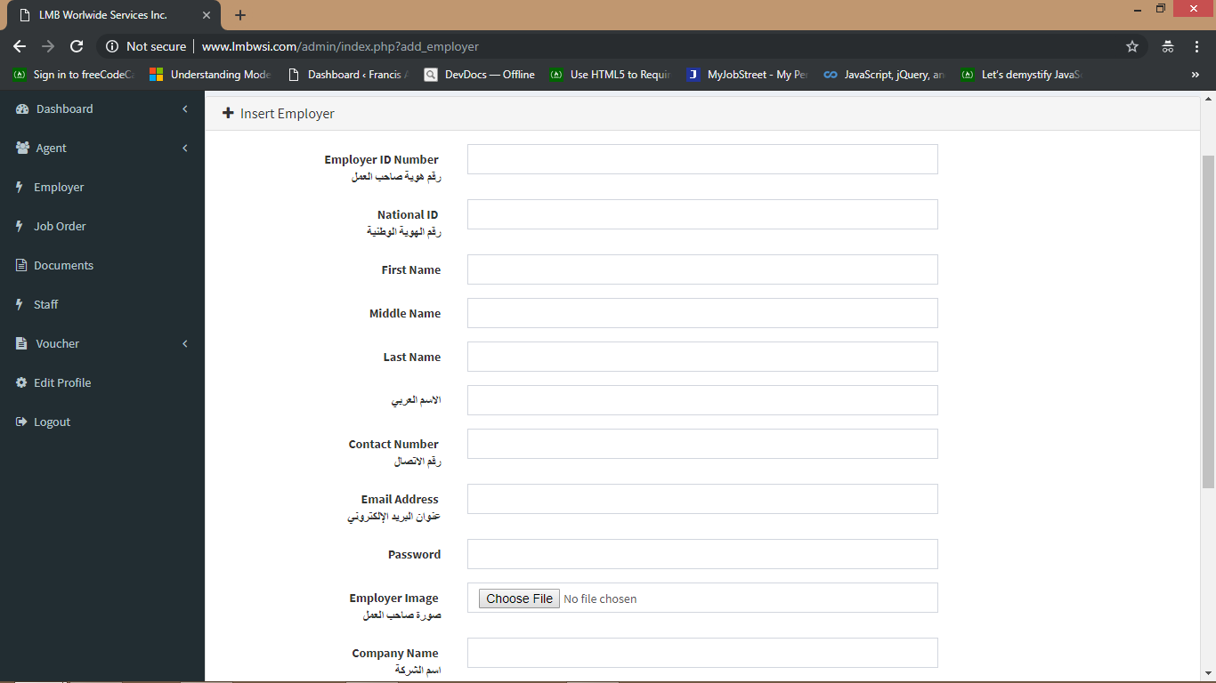

Slide 34
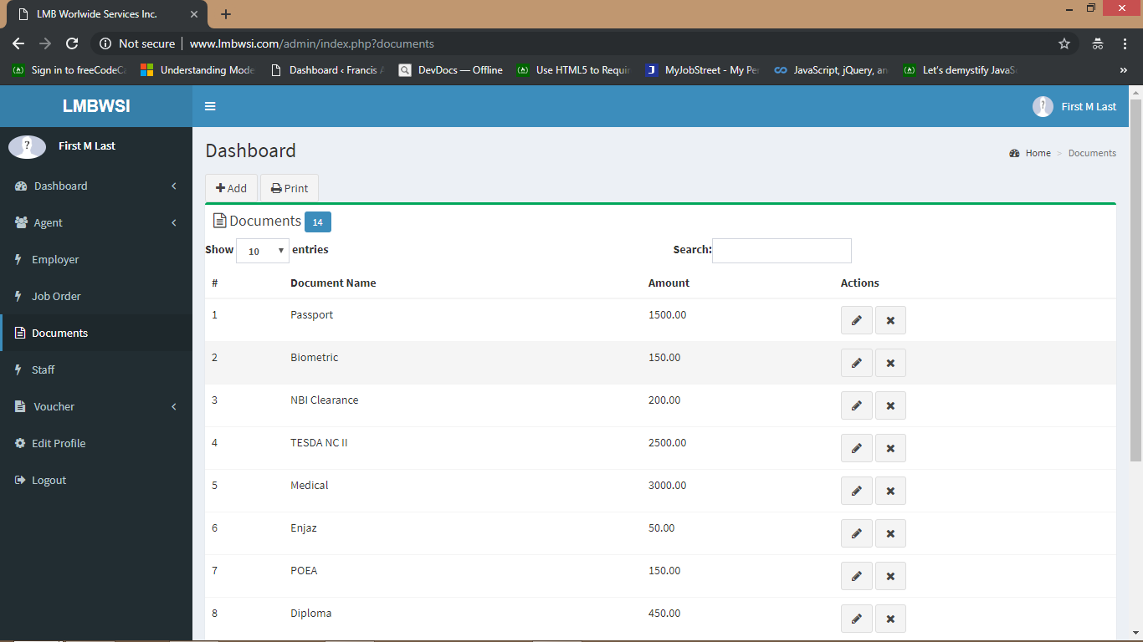
In the Documents, you can add the required documents for the applicants. You can also edit or remove it

Slide 35
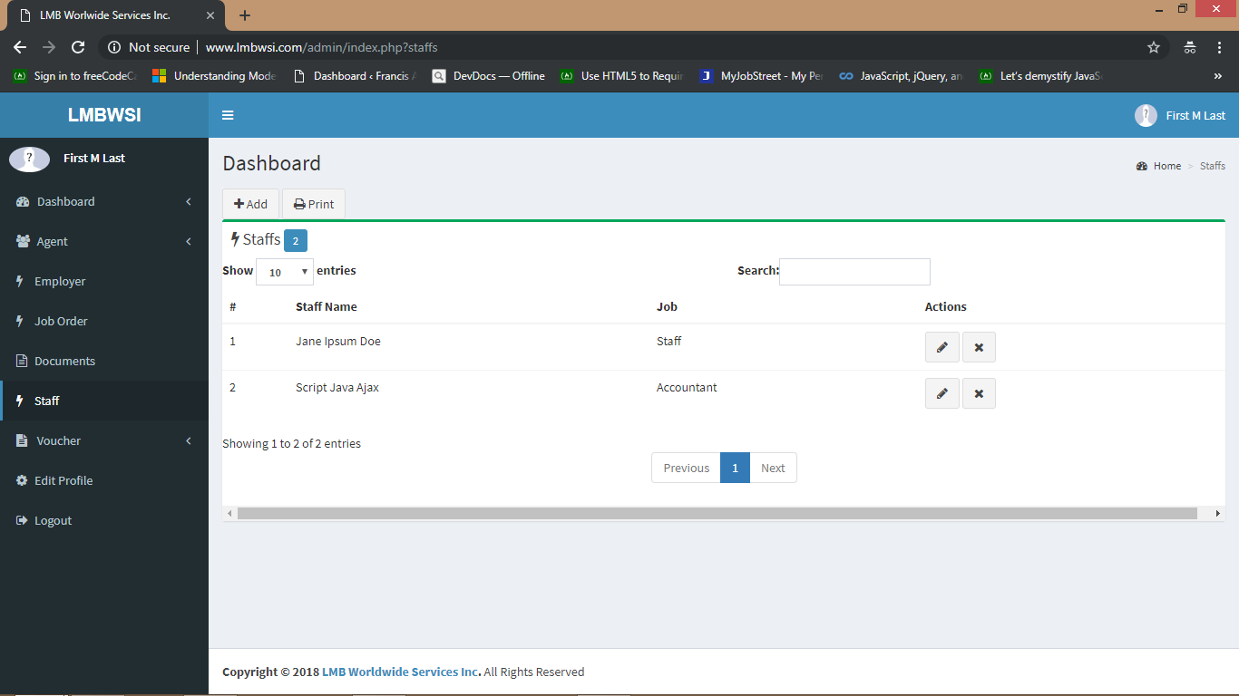
In the Staff, you can add your staffs. You can also edit or remove it

Slide 36
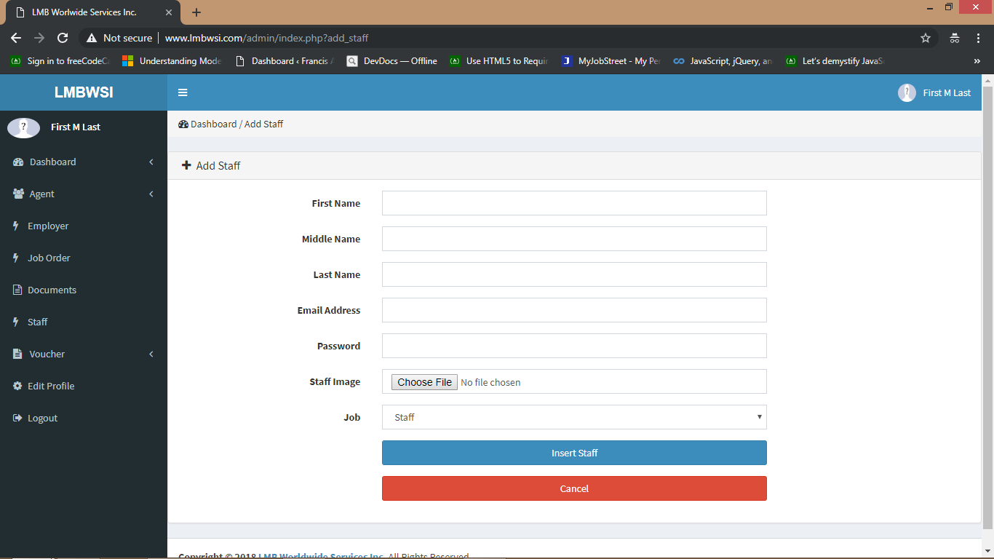
The email Address and the Password will be use to login as Staff or Accounting

Slide 37
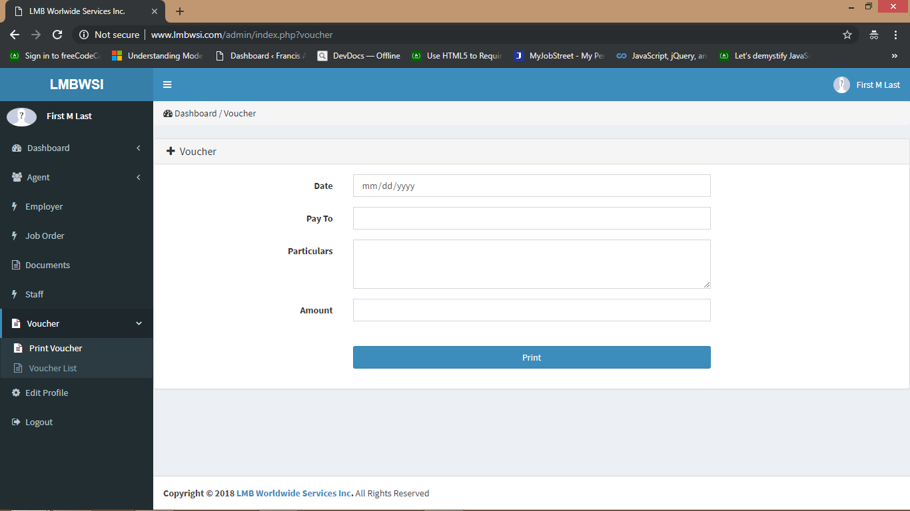
In the Voucher, you can make your voucher and click print to print it.

Slide 38
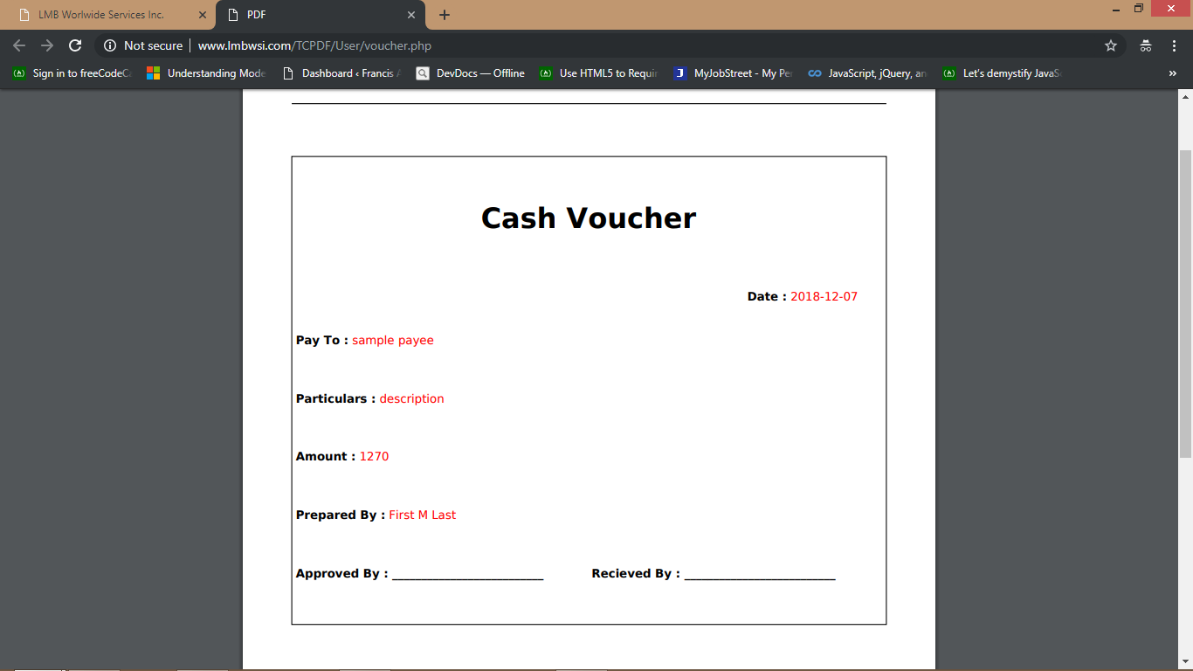
It will open a new tab to display the summary and you can print it

Slide 39
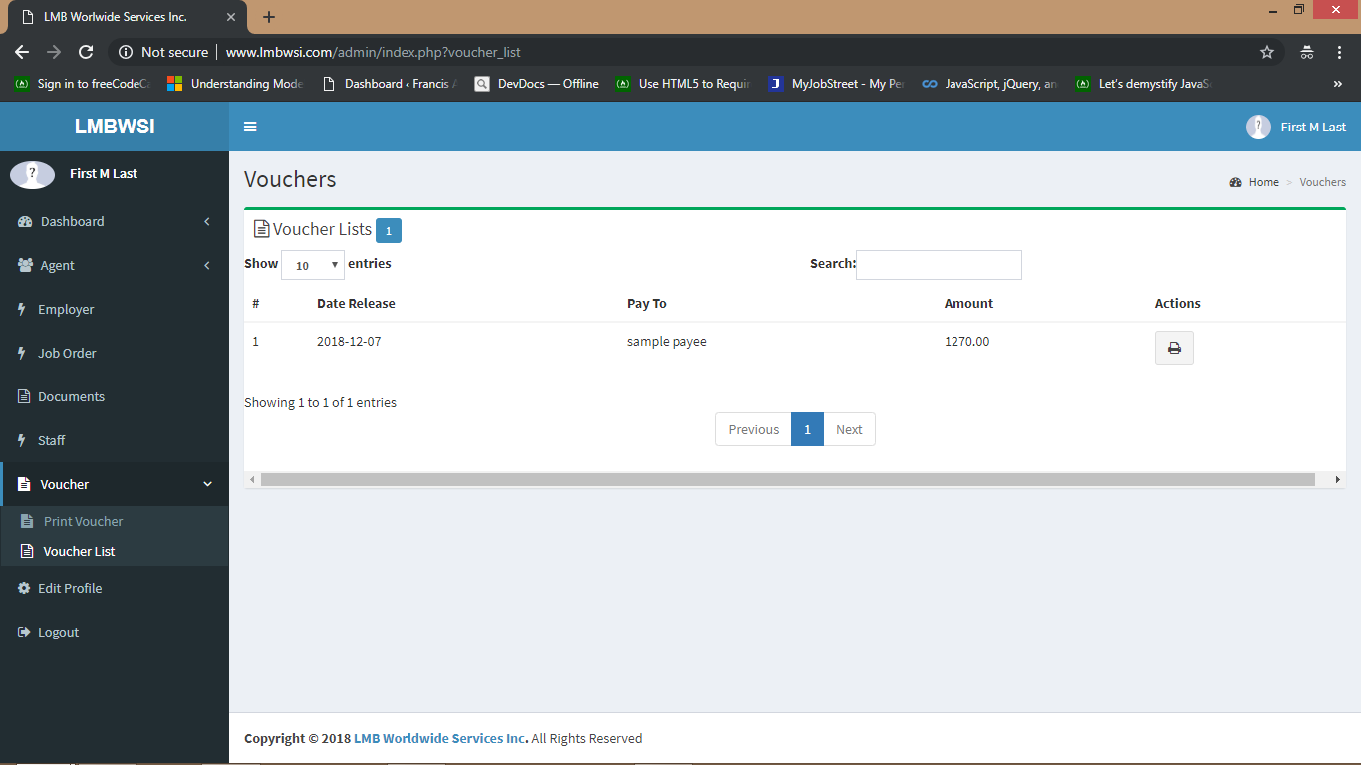
In the Voucher List, you can view previous vouchers and you can re print it

Slide 40
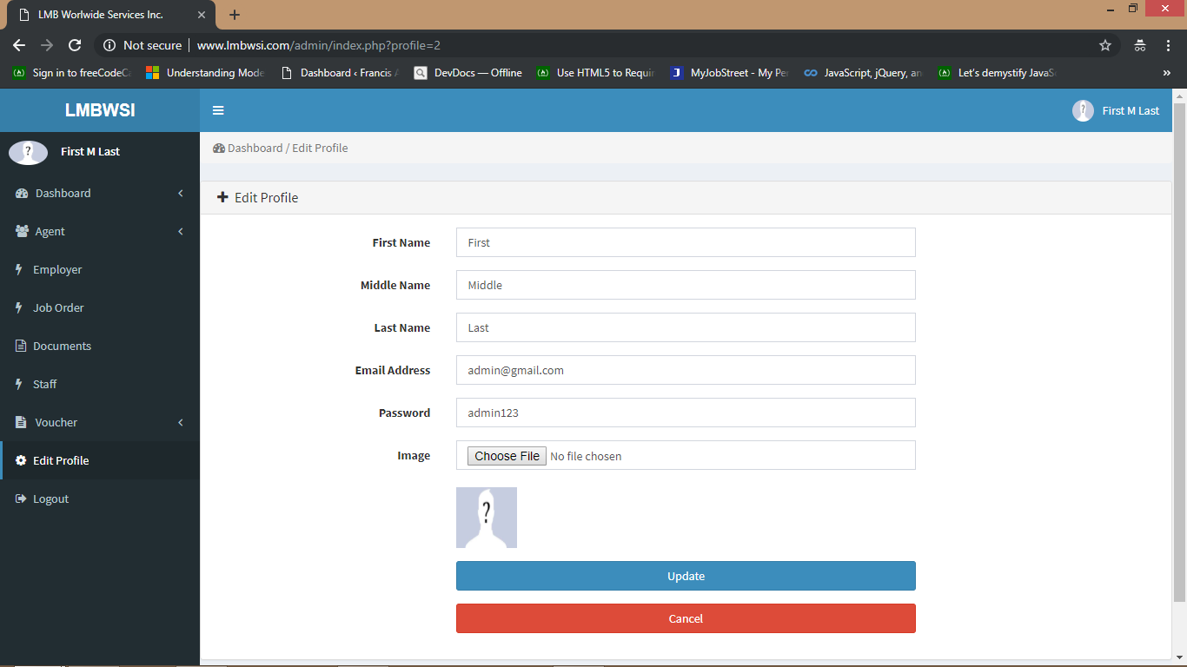
In the Edit Profile, you can edit your information. You can change your email address and password to be used when logging in

Slide 41
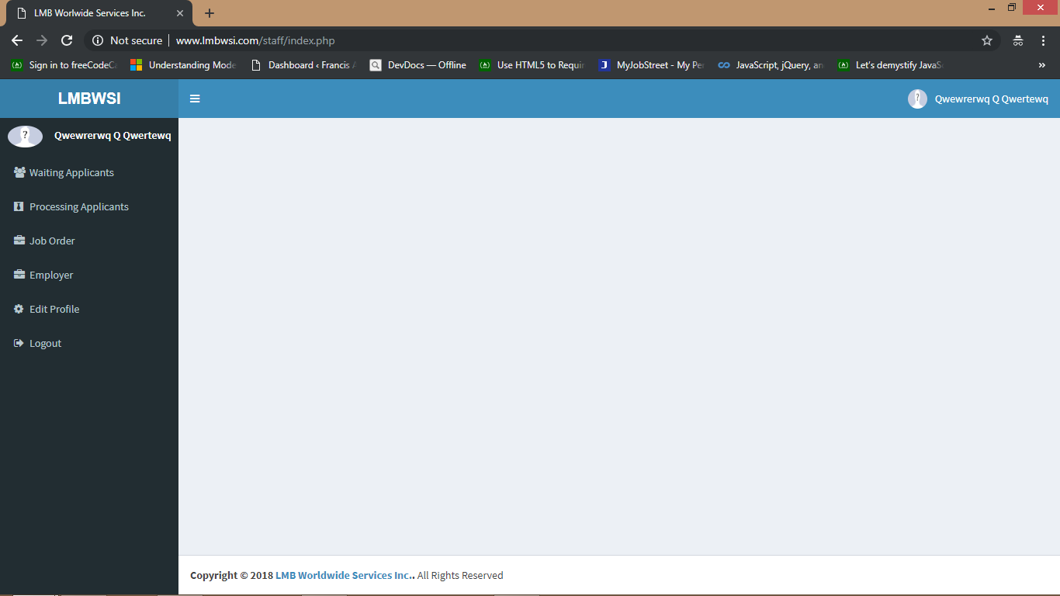
When you logged in as a staff, your access is limited to waiting applicants, processing applicants, job order, employer and edit profile

Slide 42

When you logged in as an accountant, your access is limited to agent list, vouchers and edit profile

Slide 43
If you have questions, you can contact us Yaramay Computer Maintenance Services
Contact #: 09554562584
THANK YOU

